Slide 1


The Toolshed : Inside Azure tools, your daily hammers. by Mike Martin
collabdays | lisbon
November 13th, 2021

Slide 2







Our Sponsors
GOLD
COMMUNITY

Slide 3
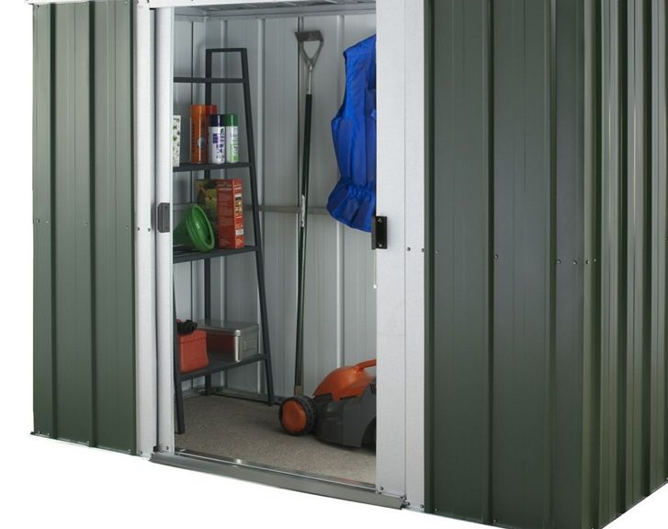
The Toolshed : Inside Azure tools, your daily hammers.
Mike Martin | @techmike2kx
Cloud Solution Architect

Slide 4
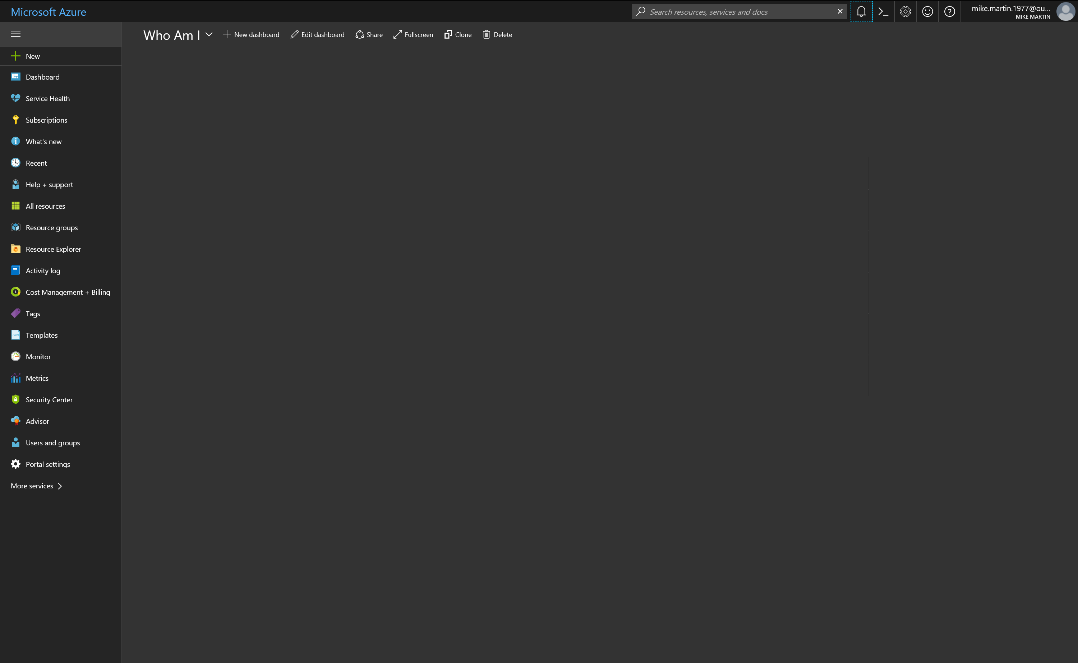

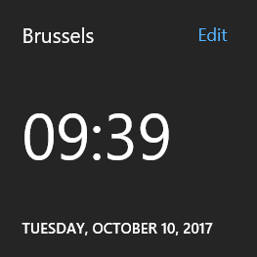
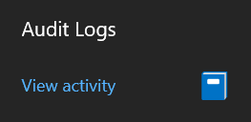



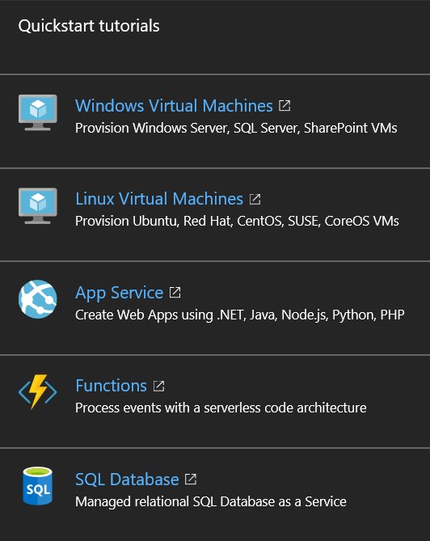





//what
Flexible
Passionate about tech
Family
Global reach
Knowledge sharing
//also
curious
Straightforward
Feedback eager!
17:52
Mike Martin
Technical Evangelist
#Azure
Ex-MVP, Advisor, User group
Social
@techmike2kx
mimar@microsoft.com

Slide 5
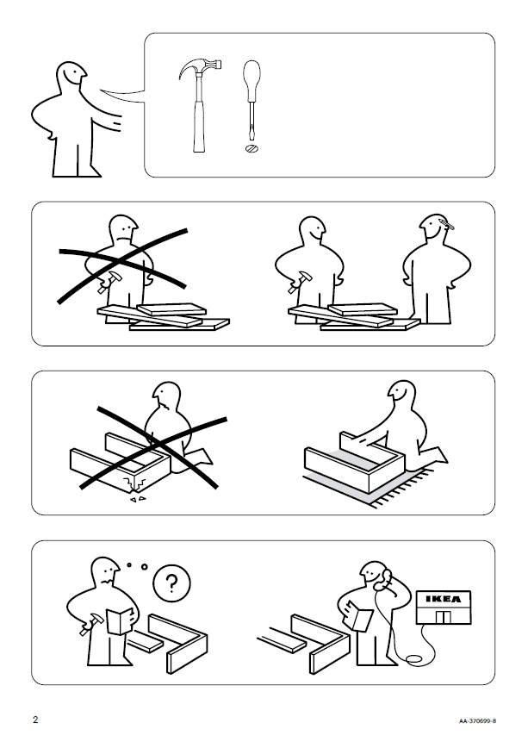
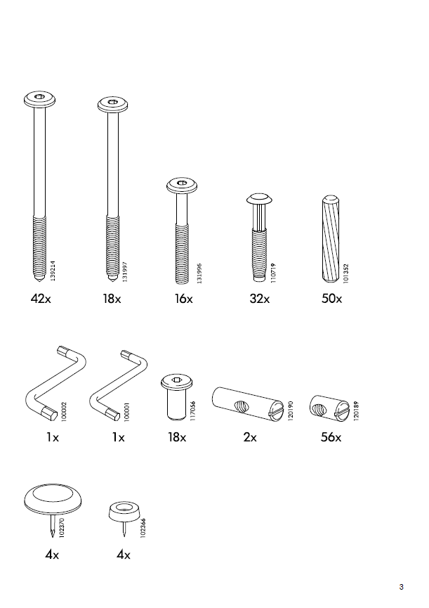
So what ‘s this about?

Slide 6

So what ‘s this about?

Slide 7

Sometimes you only have basic tools
Don’t get me wrong , they’ll do the job, … somehow.

Slide 8
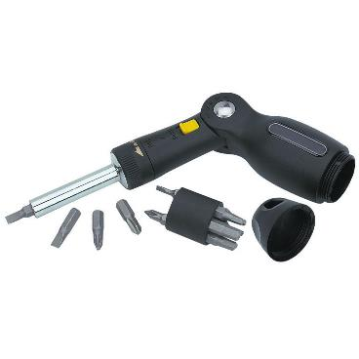
Evolve and improve

Slide 9

To this

Slide 10

But it could also be that you need another tool

Slide 11
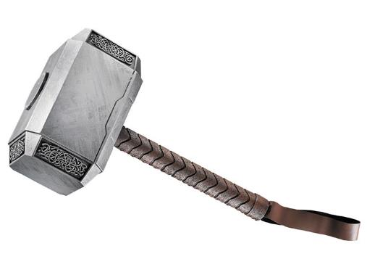
And that will need evolution also

Slide 12

And eventually you want to end up with this (maybe)

Slide 13

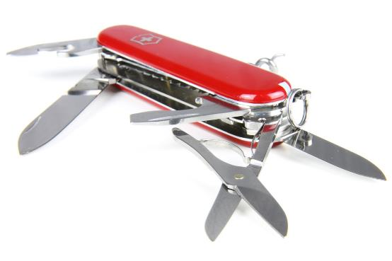
Cause …. With the right tool

Slide 14

Well, you’ll get the idea .. Right?

Slide 15
Name that tool
So let’s apply what we just discussed:
Start basic
Improve
Maximize
Ultimate Goal : Become the Doctor / MacGyver / Batman

Slide 16
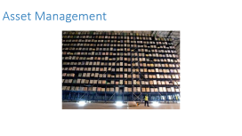
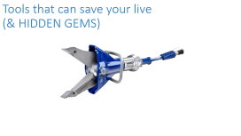

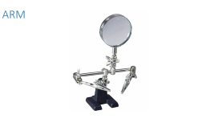
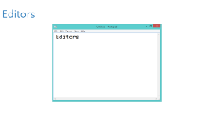



Slide 17
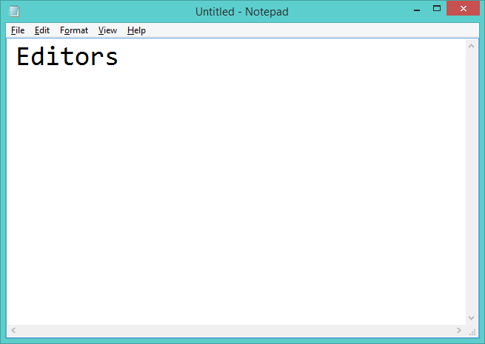
Editors

Slide 18
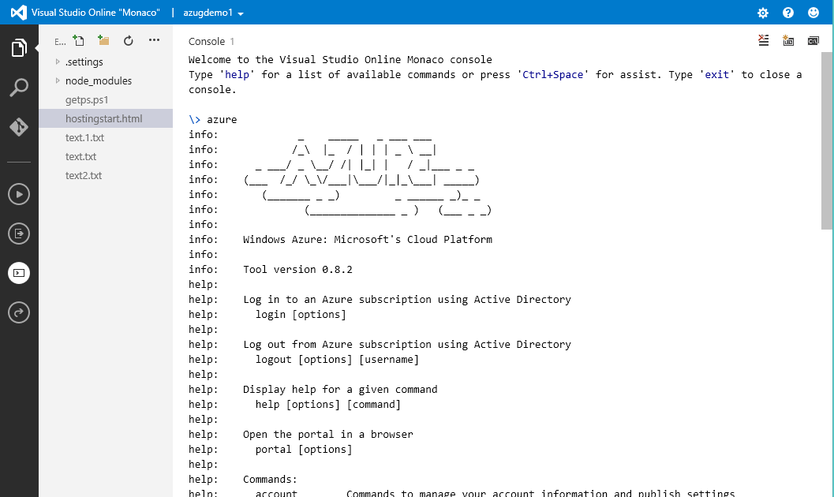
Monaco / App Service Editor
https://<yourwebapp>.scm.azurewebsites.net/dev
Selfhost : https://github.com/microsoft/monaco-editor

Slide 19
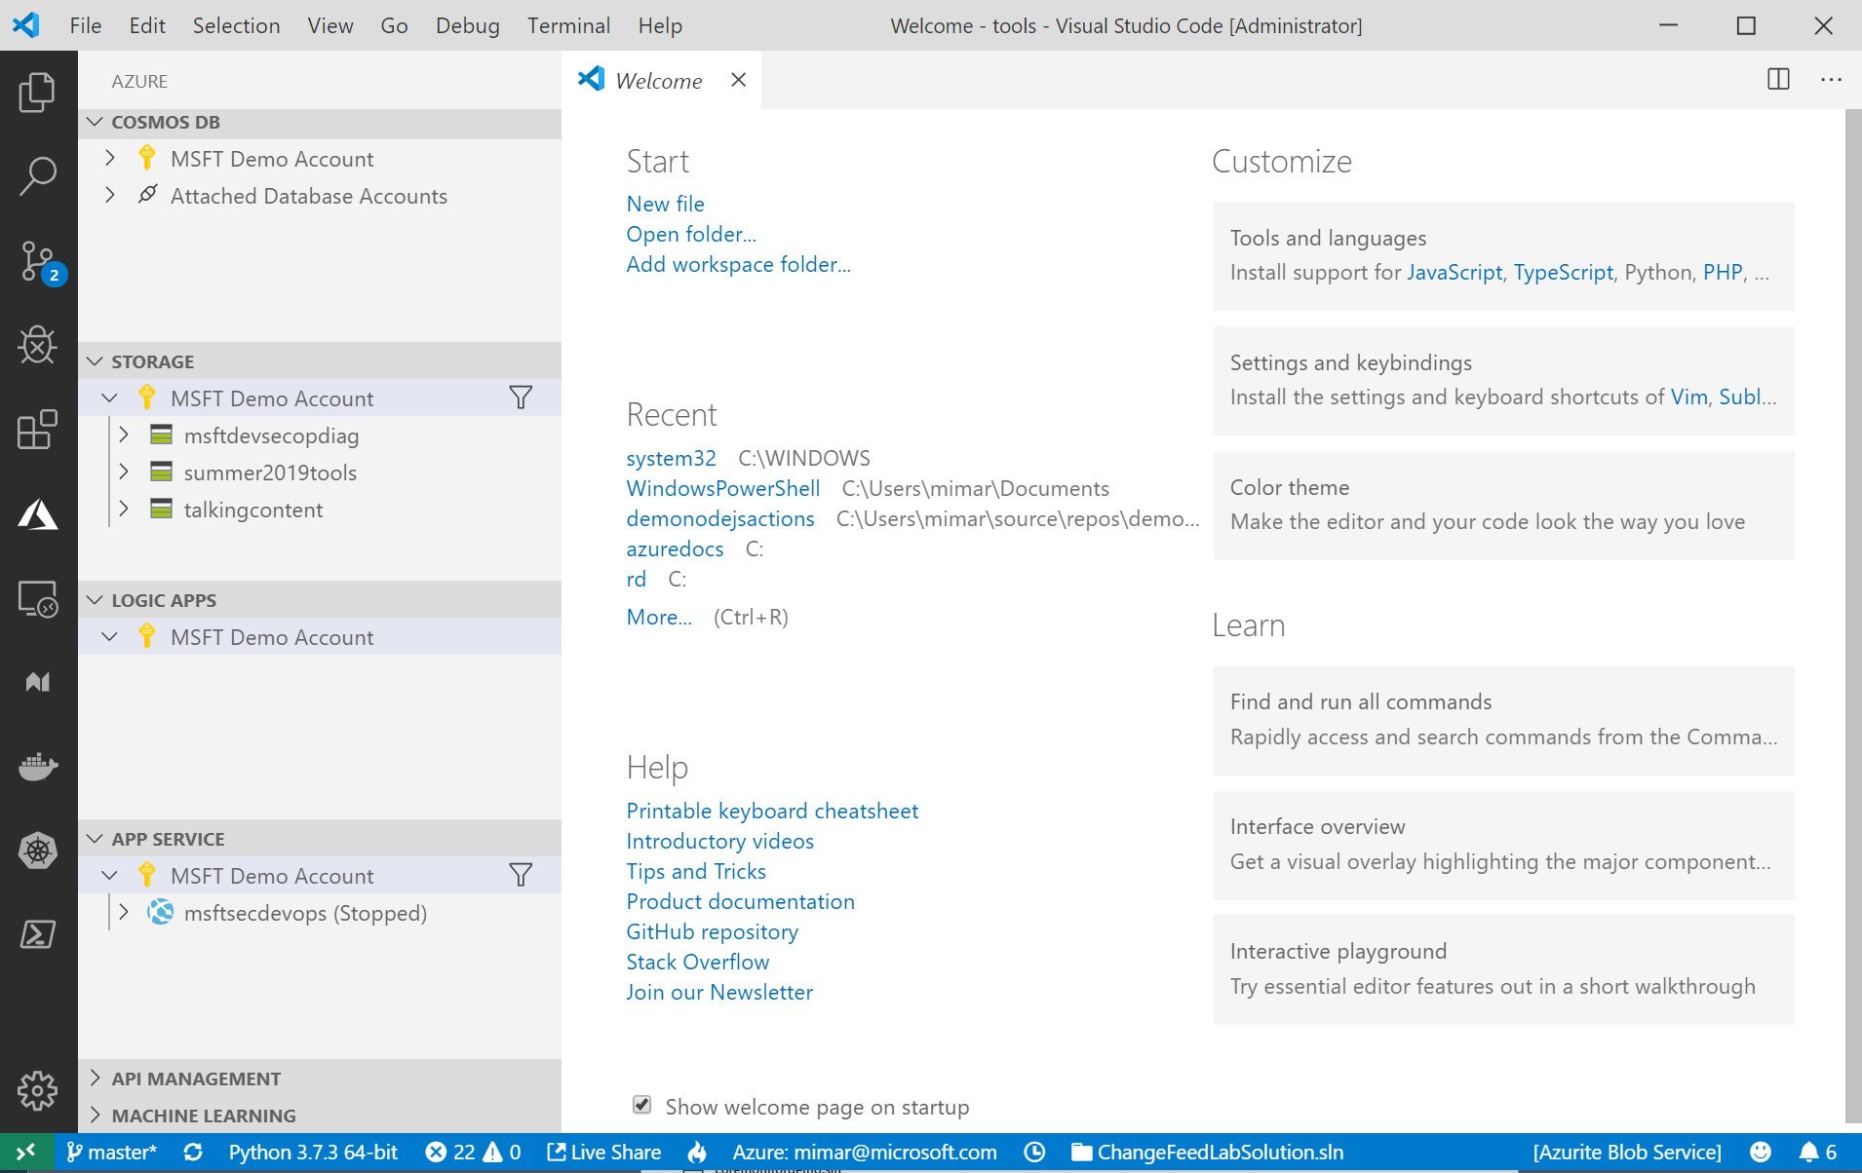
Code
https://code.visualstudio.com
Azure Tools Extension : https://aka.ms/azurevscode

Slide 20
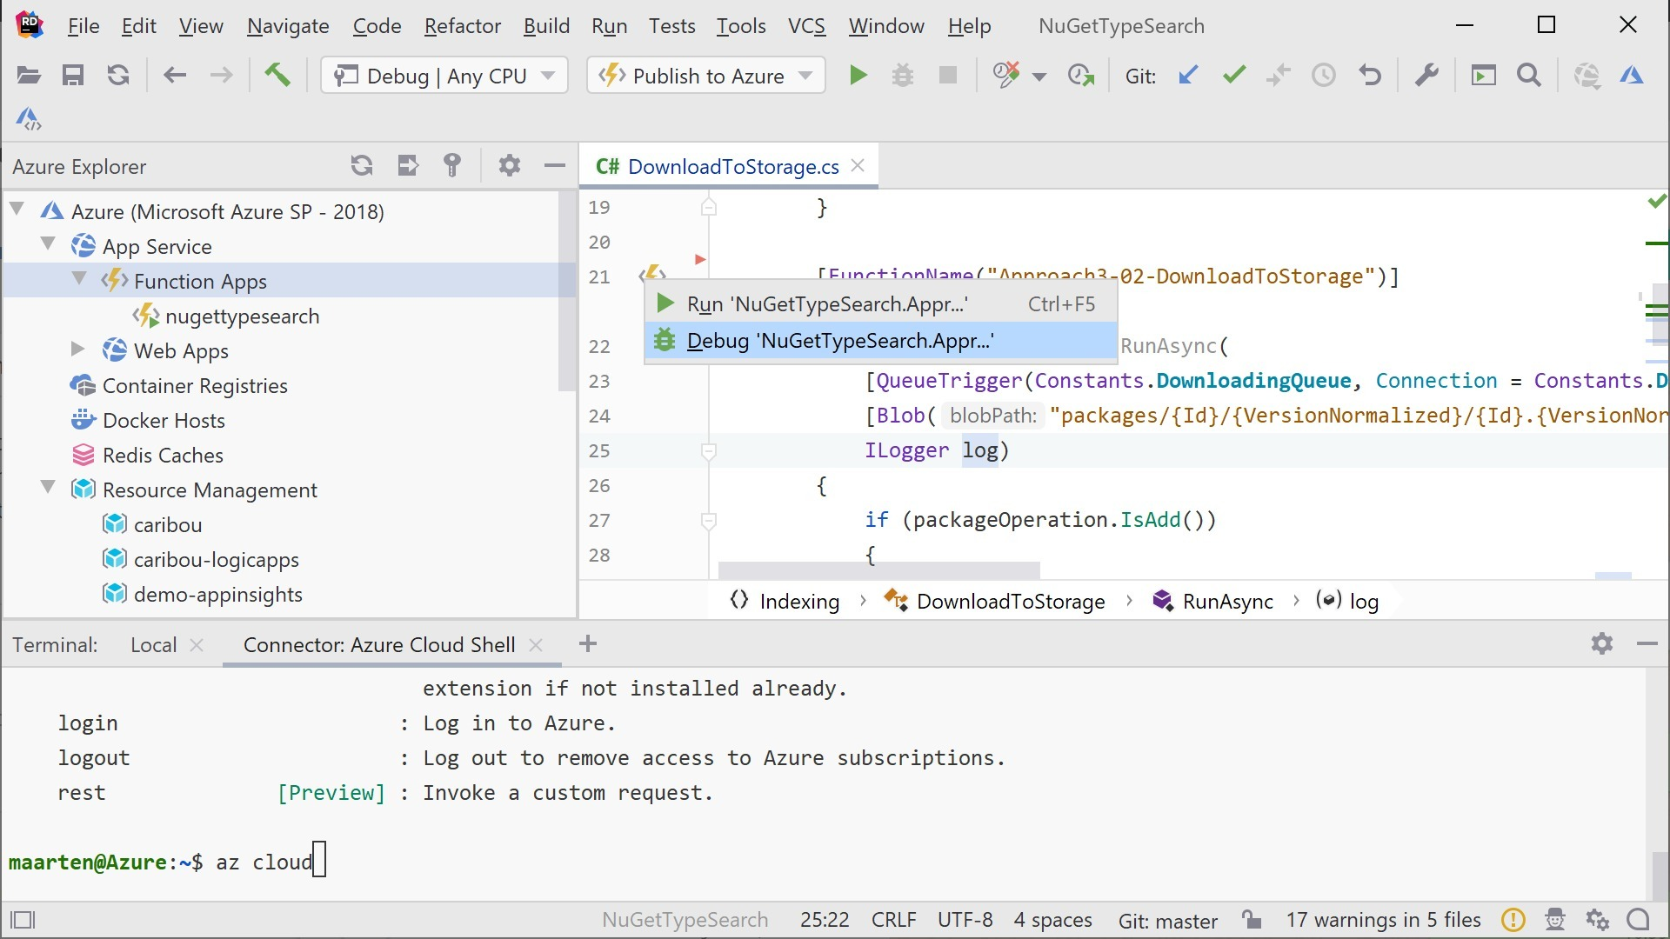
3rd party by JB : Rider and IntelliJ
Azure Tools plug-in : https://aka.ms/azureIntelliJ

Slide 21
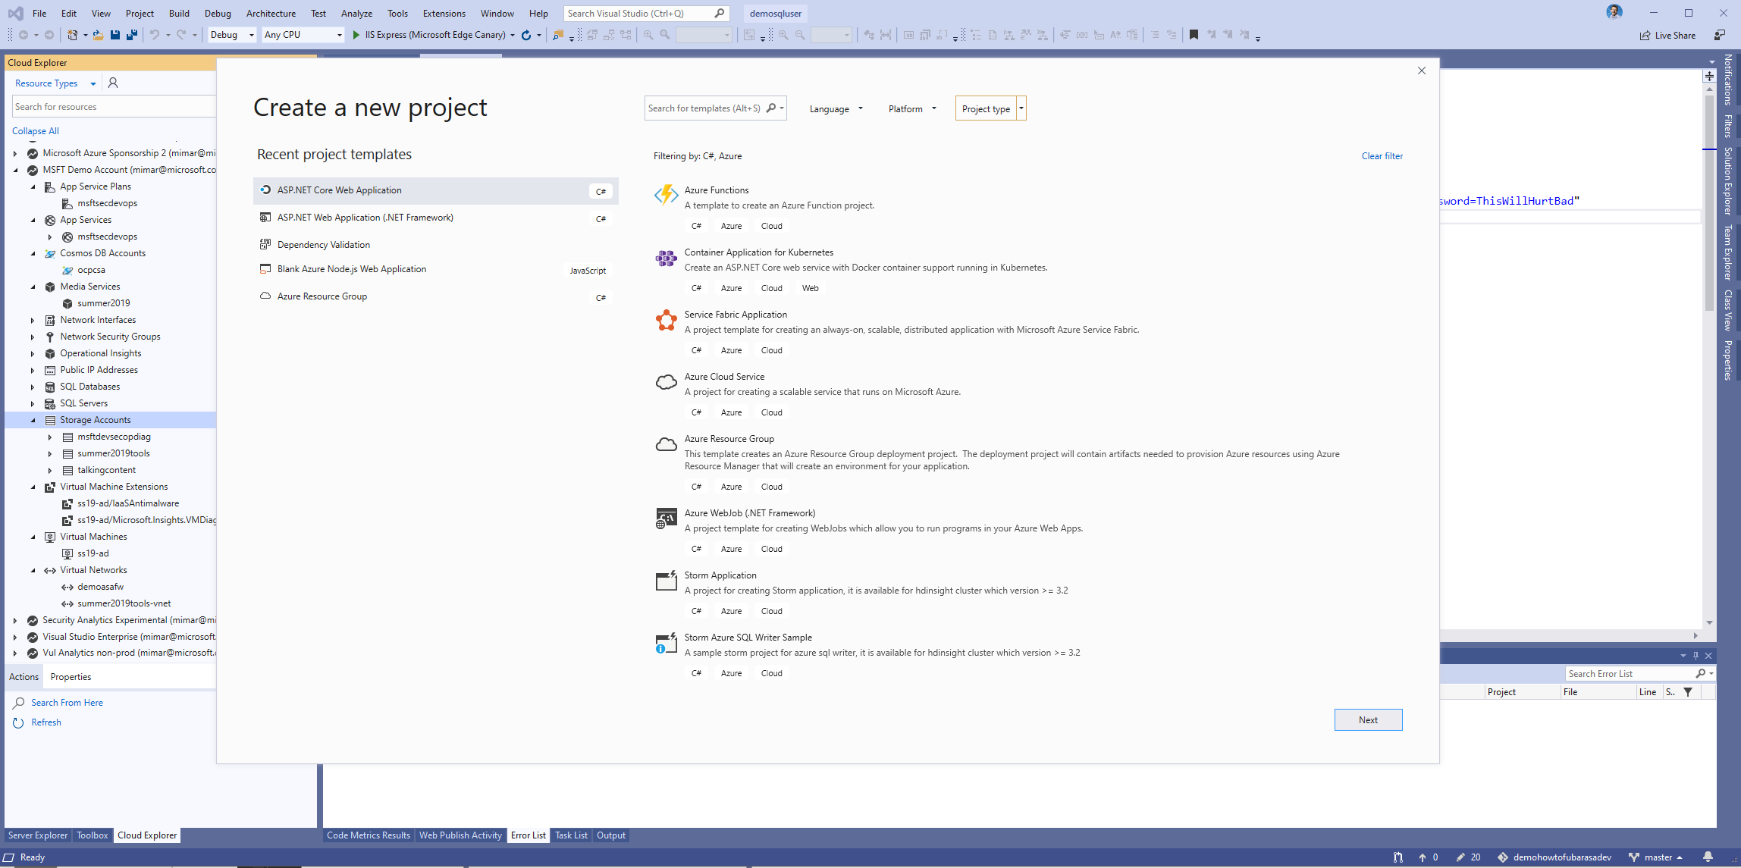
Visual Studio
https://www.visualstudio.com

Slide 22

Monitoring

Slide 23
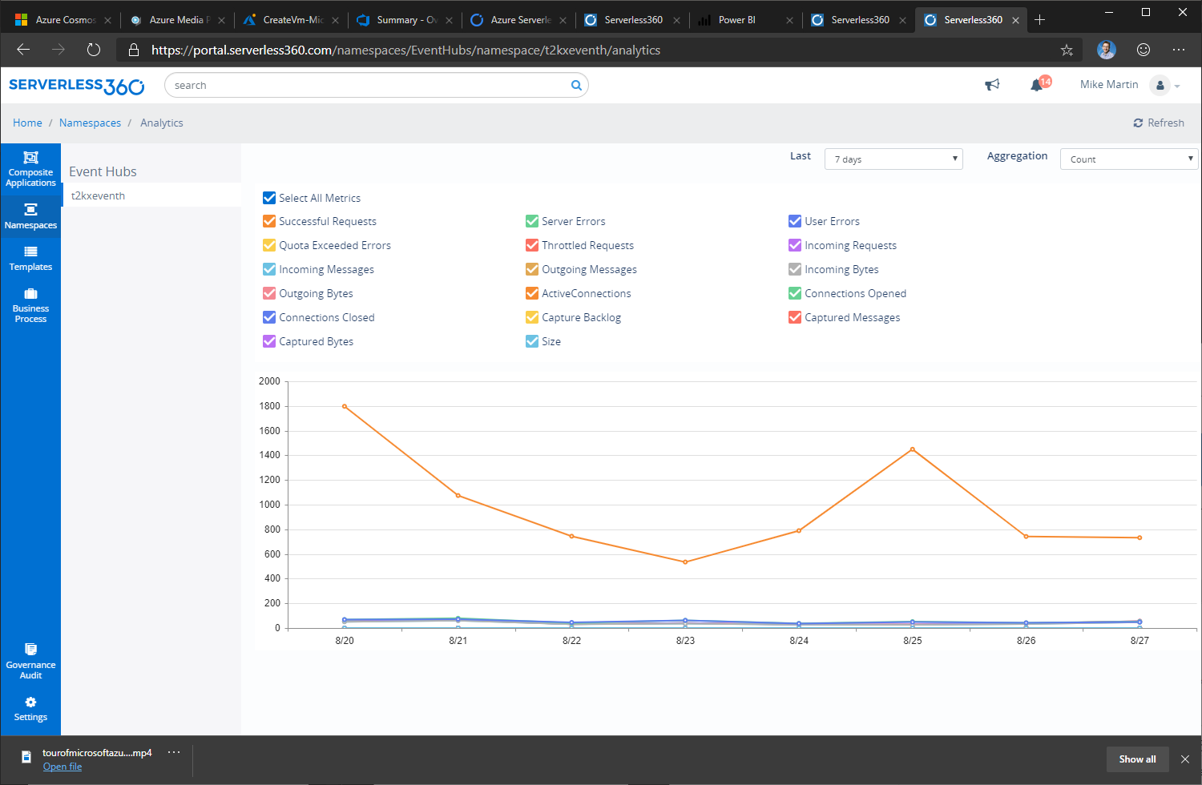
Serverless360
https://serverless360.com

Slide 24
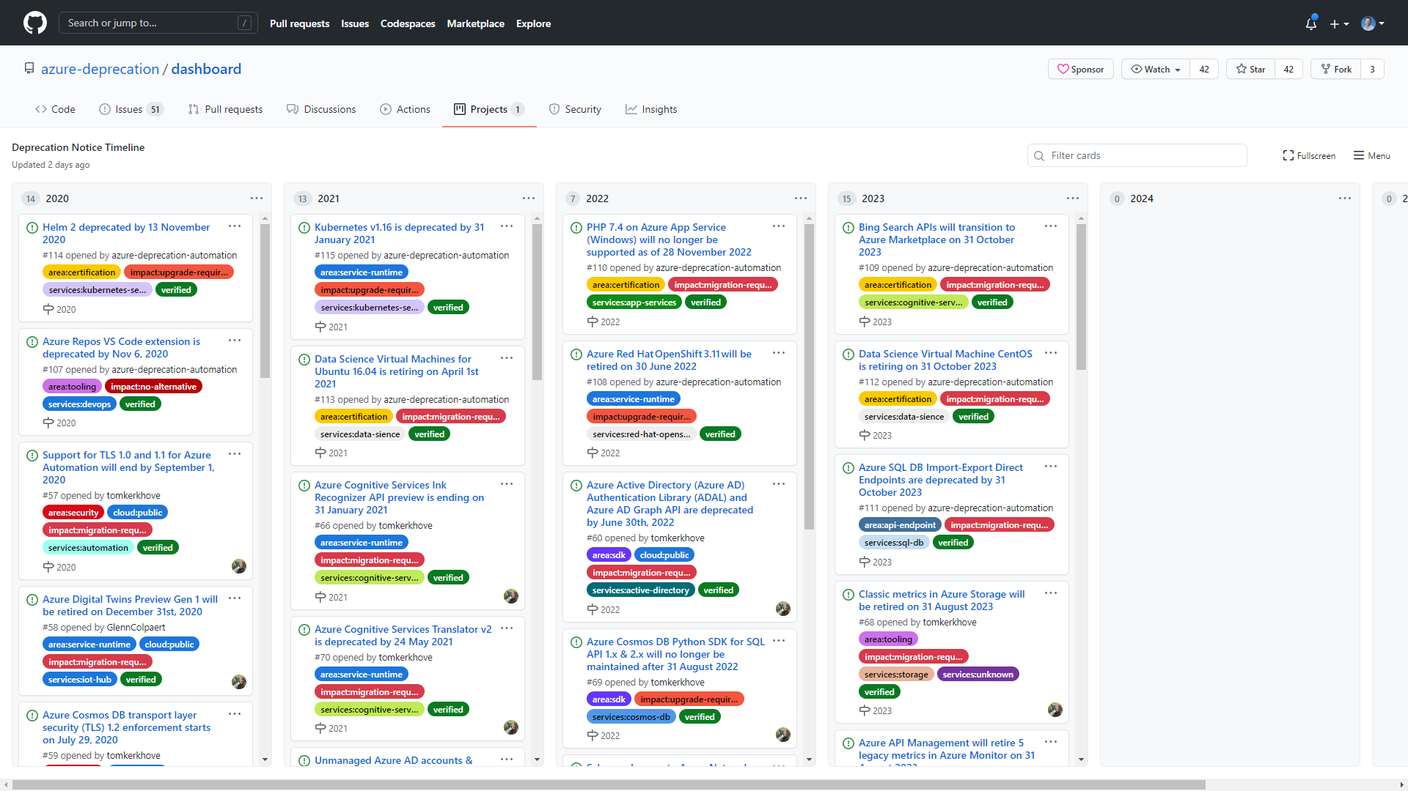
Azure Deprecation Dashboard
https://github.com/azure-deprecation/dashboard

Slide 25
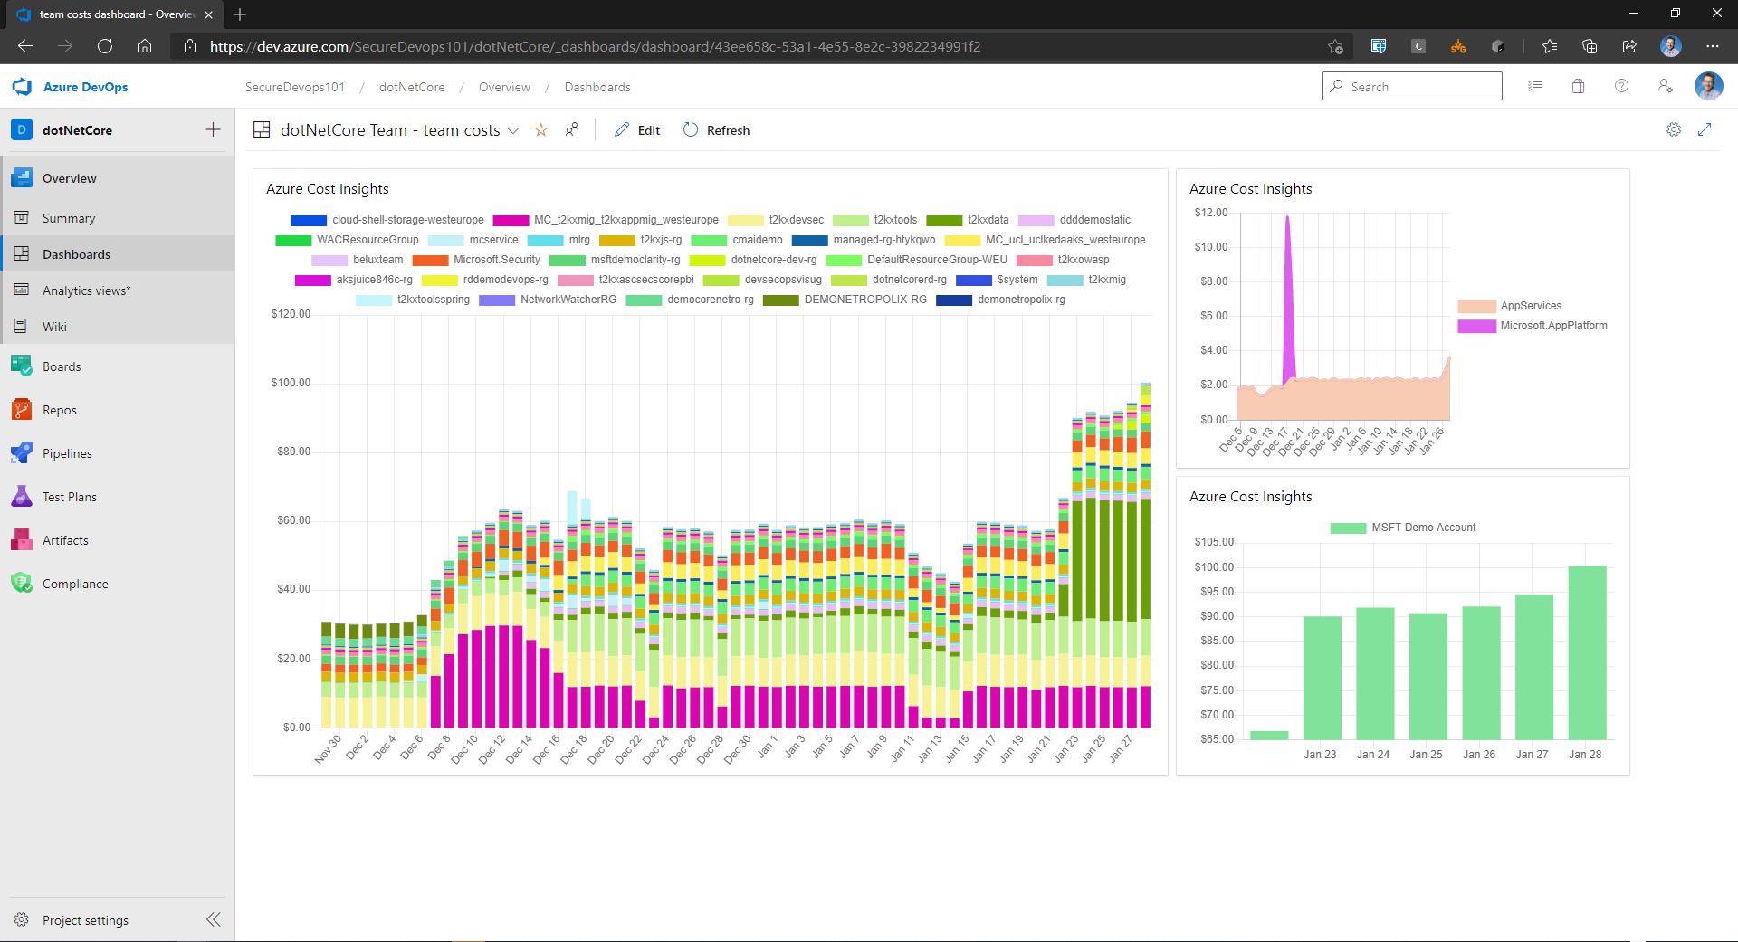
Azure Cost Insights
https://marketplace.visualstudio.com/items?itemName=keesschollaart.AzureCostInsights

Slide 26
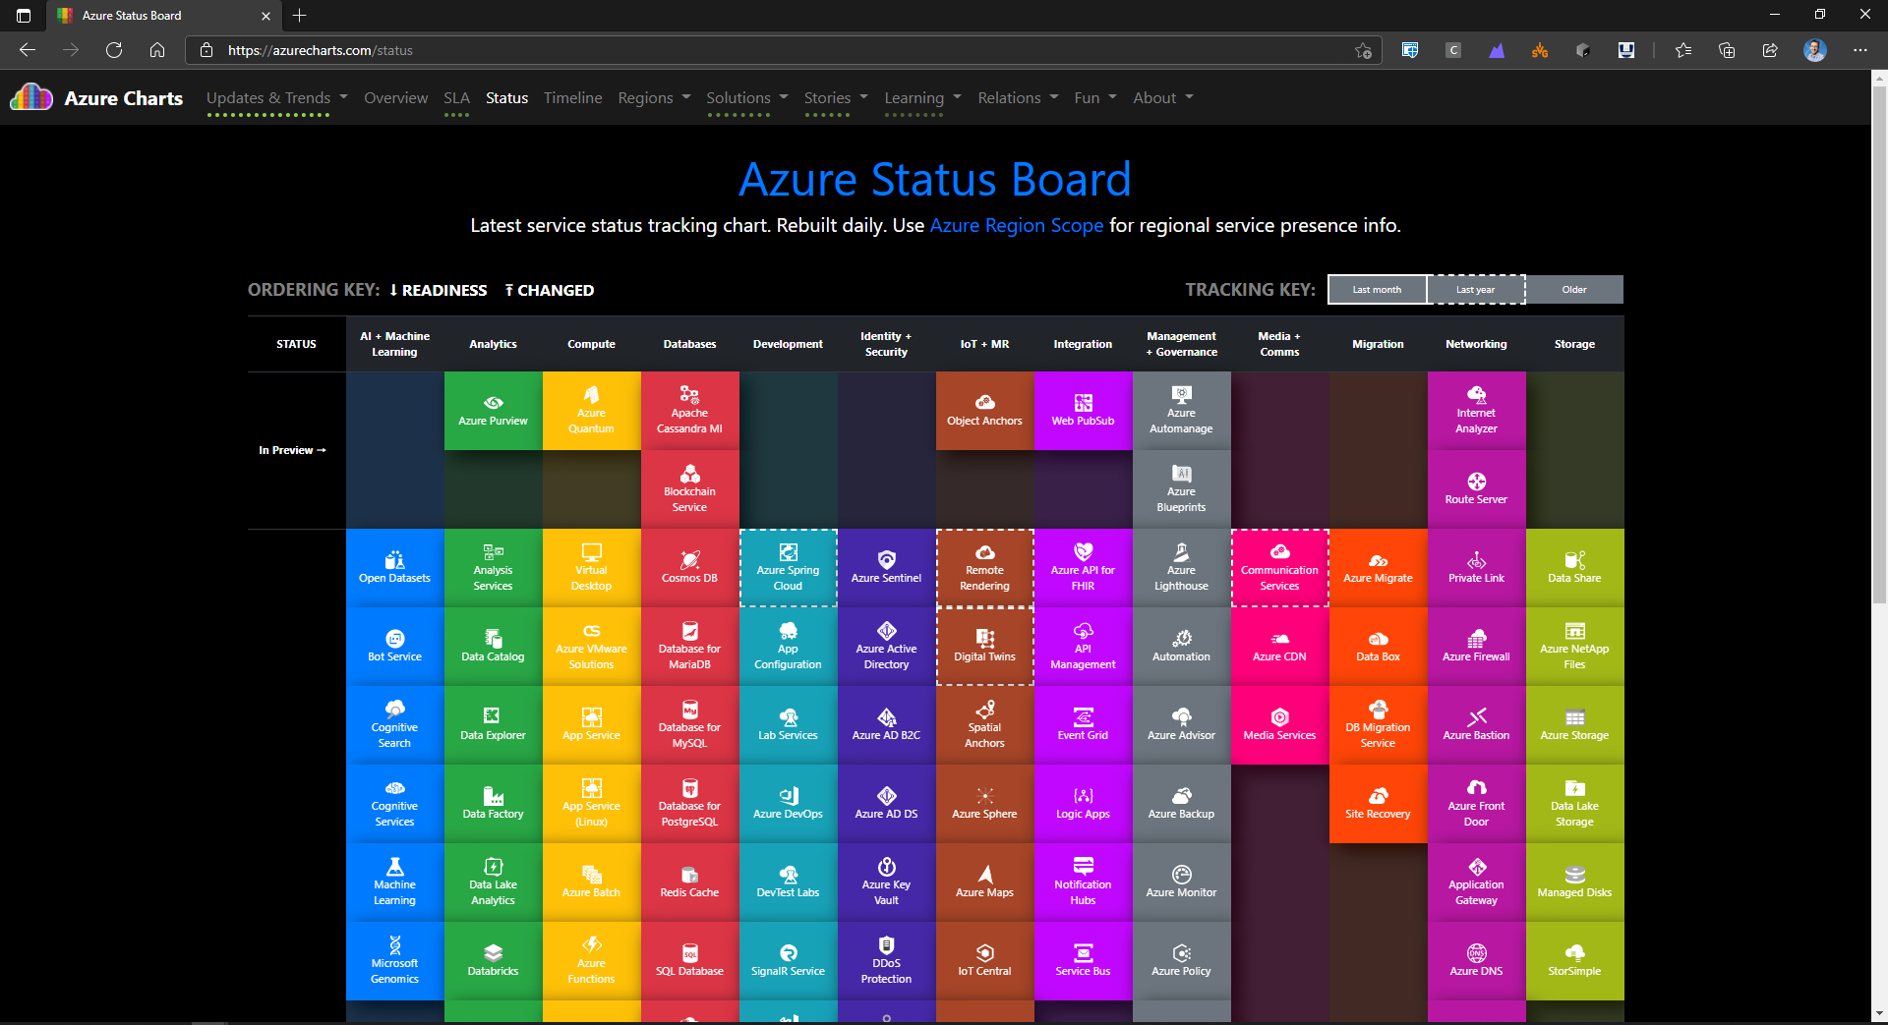
Azure Charts
https://azurecharts.com

Slide 27

Asset Management

Slide 28
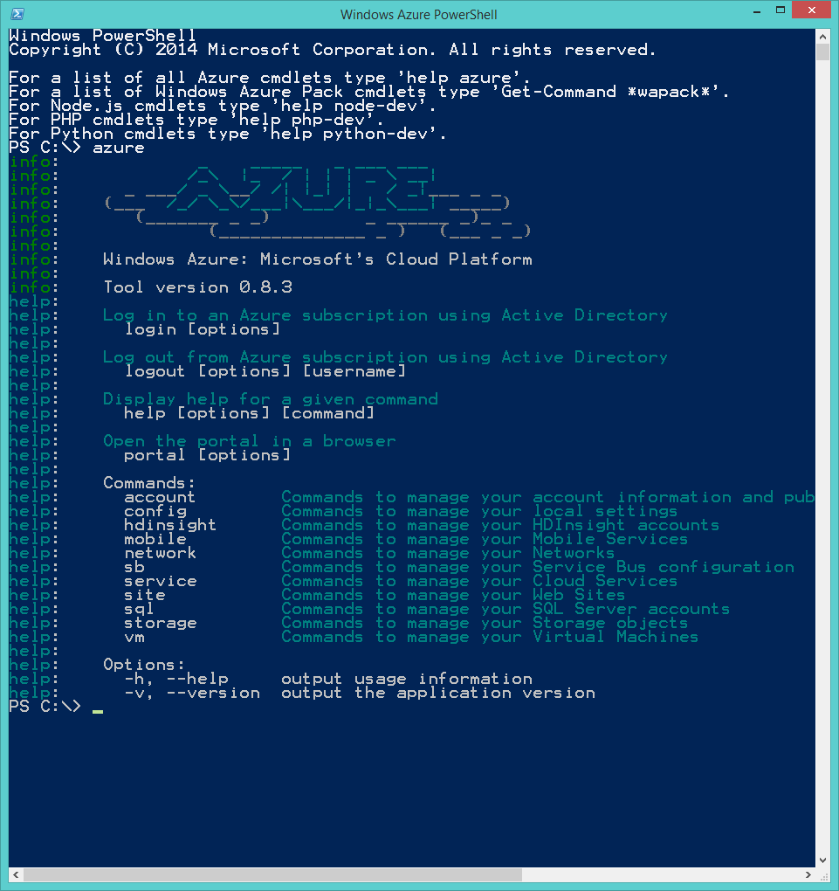
Powershell / Azure CLI Tools
https://aka.ms/azuretools

Slide 29
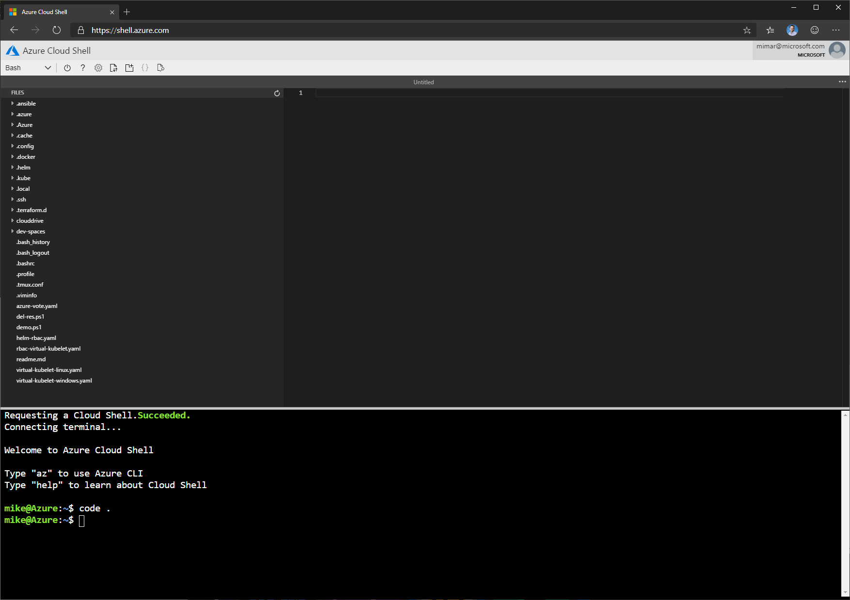
Azure Cloudshell
https://shell.azure.com/

Slide 30
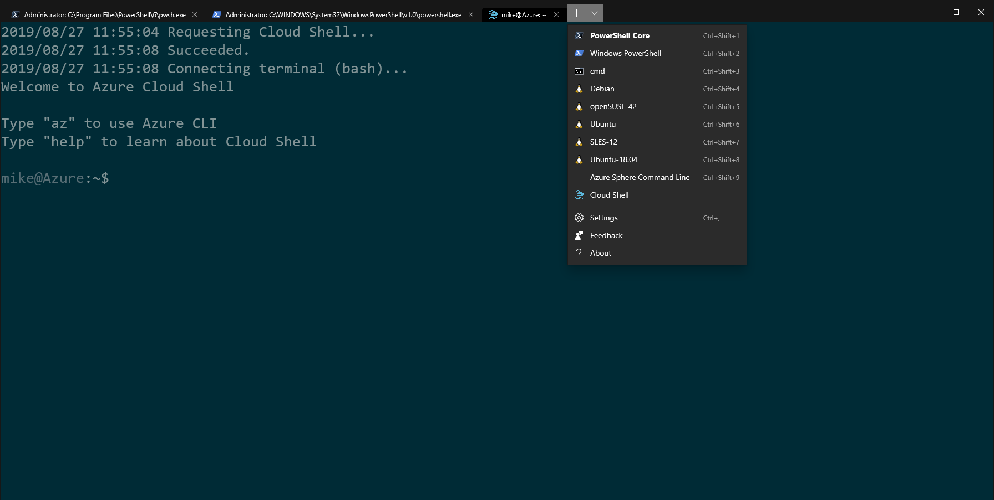
Terminal
https://aka.ms/WindowsTerminal
Cloudshell in Terminal: https://aka.ms/azurevscode

Slide 31
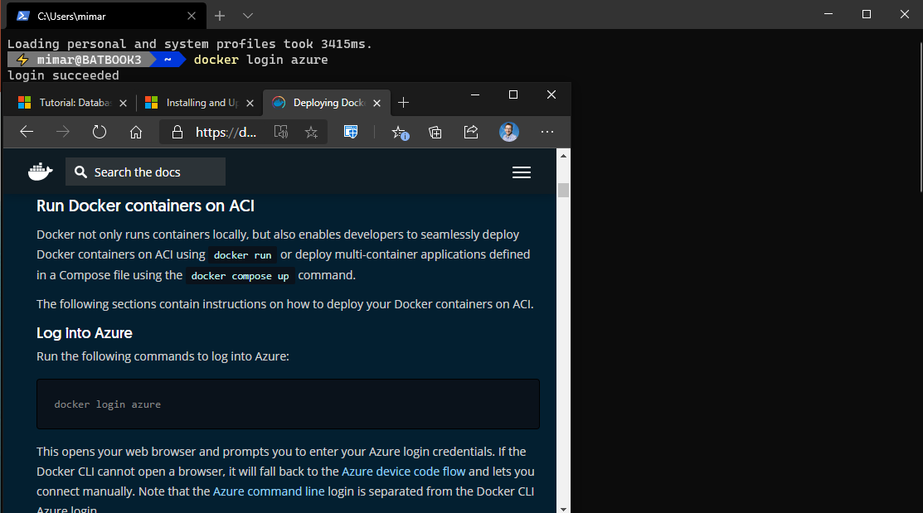
Docker CLI
https://aka.ms/ACIDocker

Slide 32
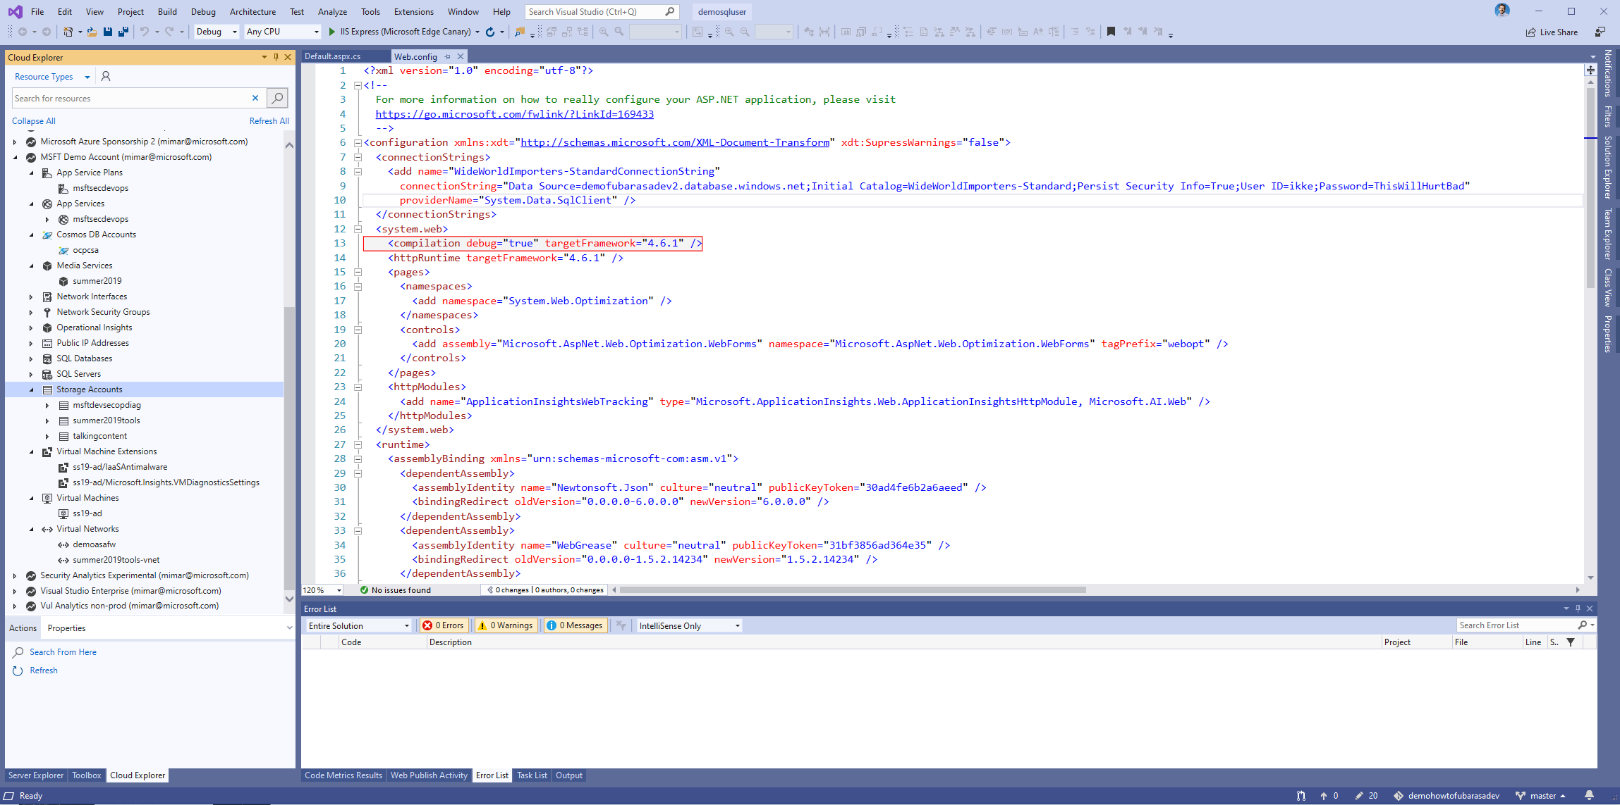
Visual Studio + SDK
https://www.visualstudio.com

Slide 33
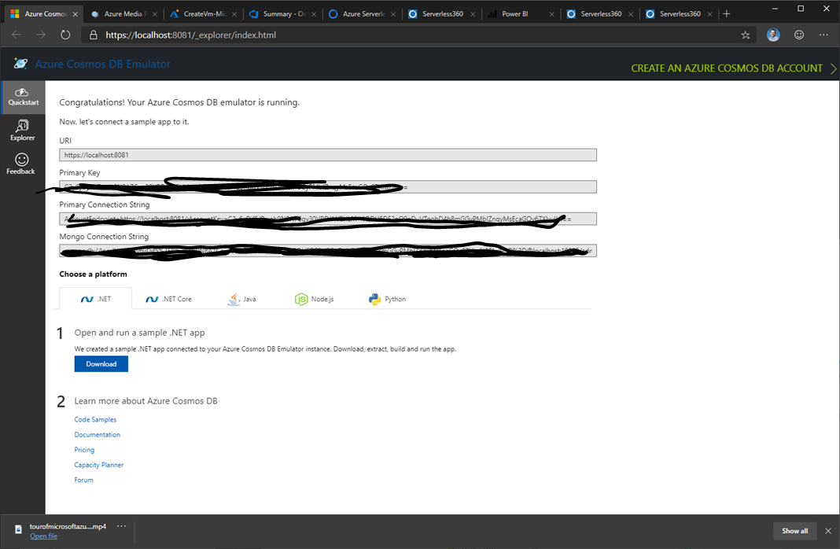
CosmosDB Emulator
https://aka.ms/cosmosdb-emulator
Use in CI/CD with Devops: https://aka.ms/cosmosdbdevops

Slide 34
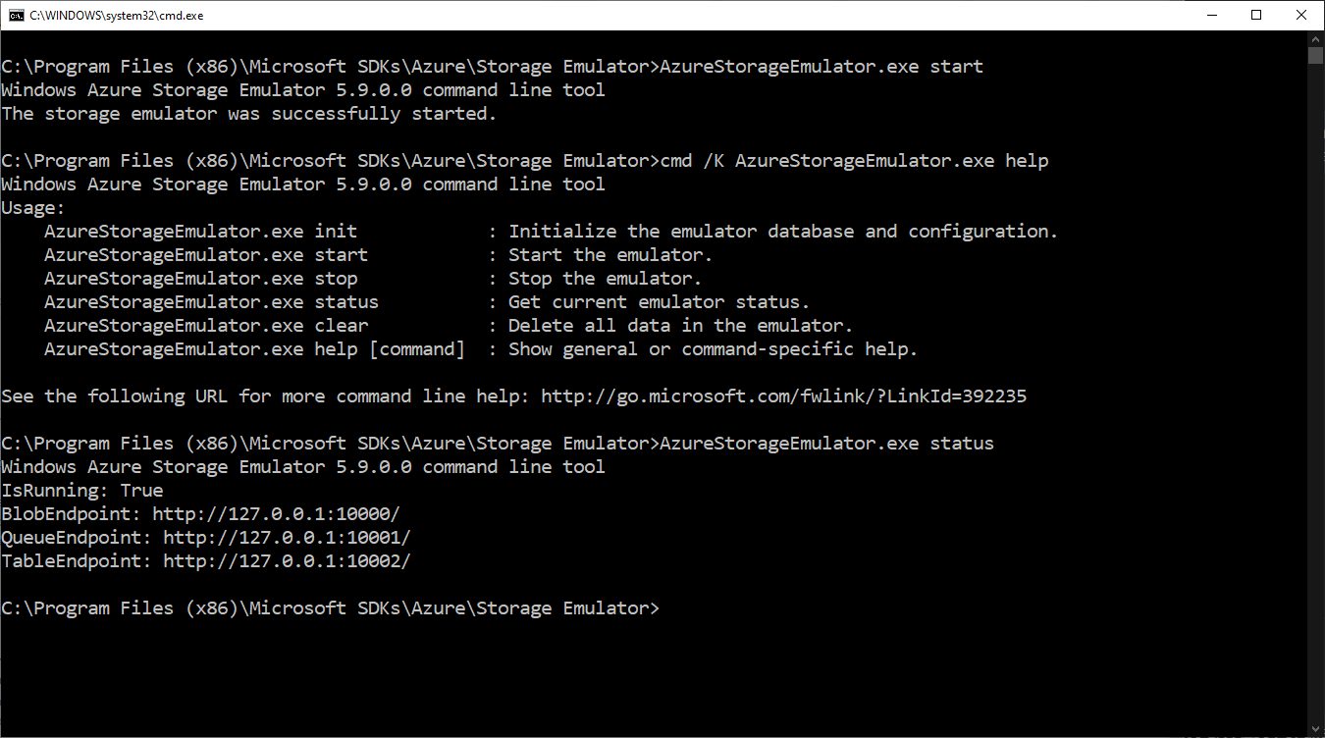
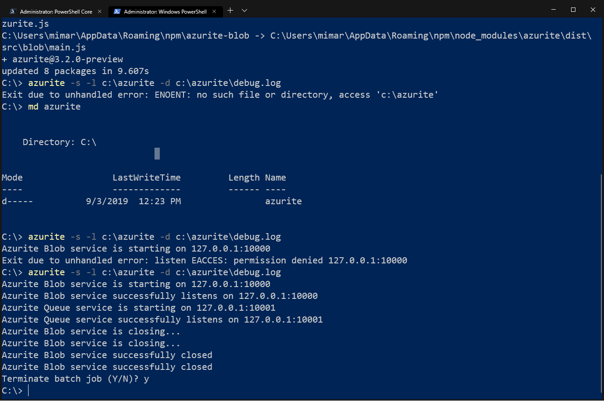
Storage Emulator + AzCopy + Azurite
Azure Storage Emulator
https://azure.microsoft.com/en-us/downloads/
Azurite
https://github.com/azure/azurite

Slide 35
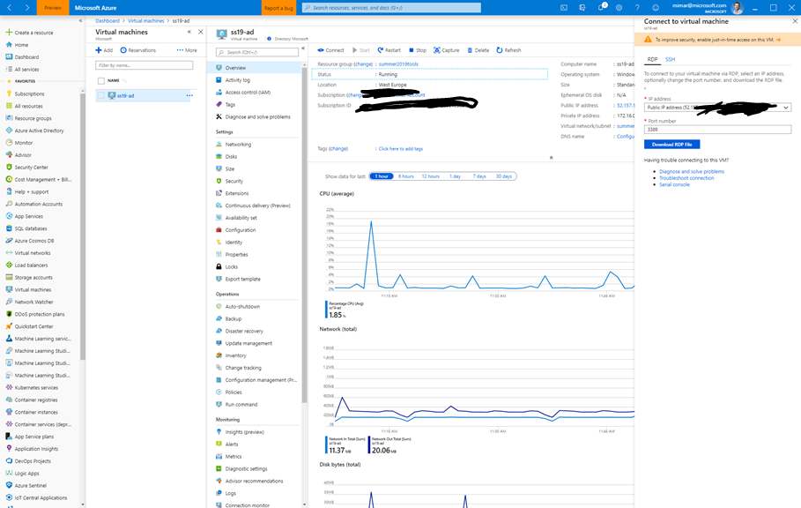
Portal App
https://portal.azure.com/App/Download
Or open https://portal.azure.com in Internet Explorer

Slide 36
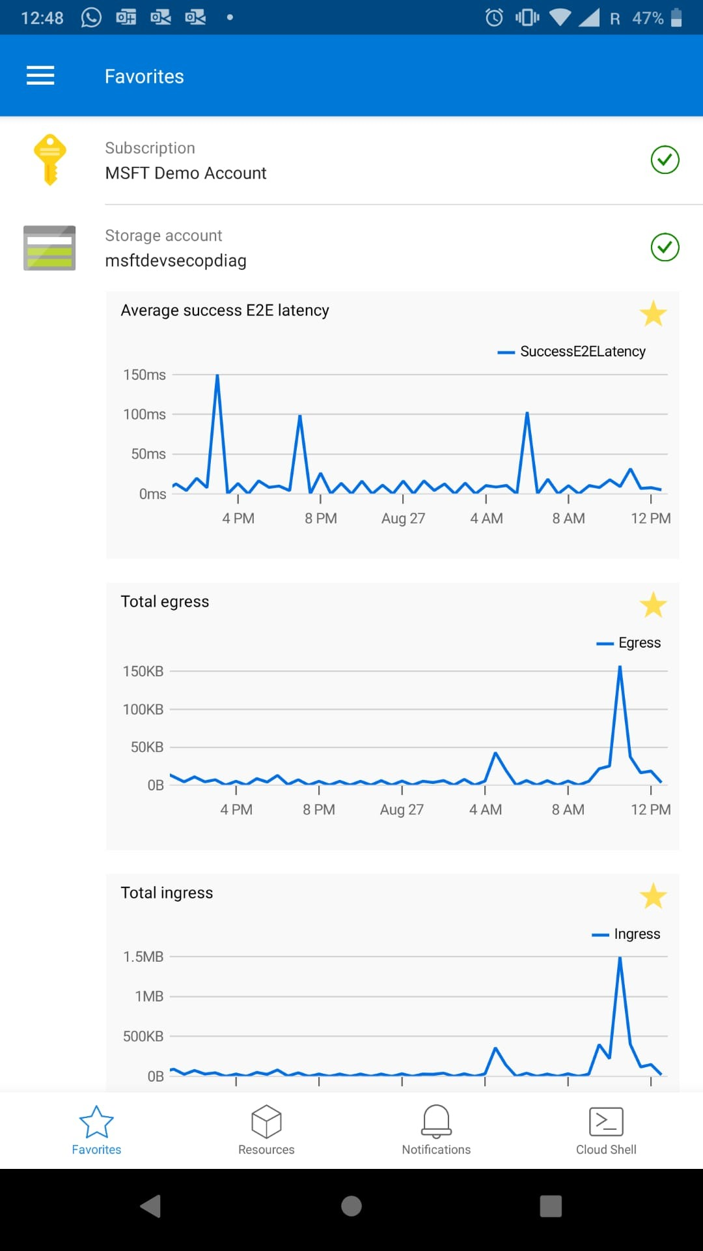

Mobile App
https://aka.ms/AzureMobileApp

Slide 37
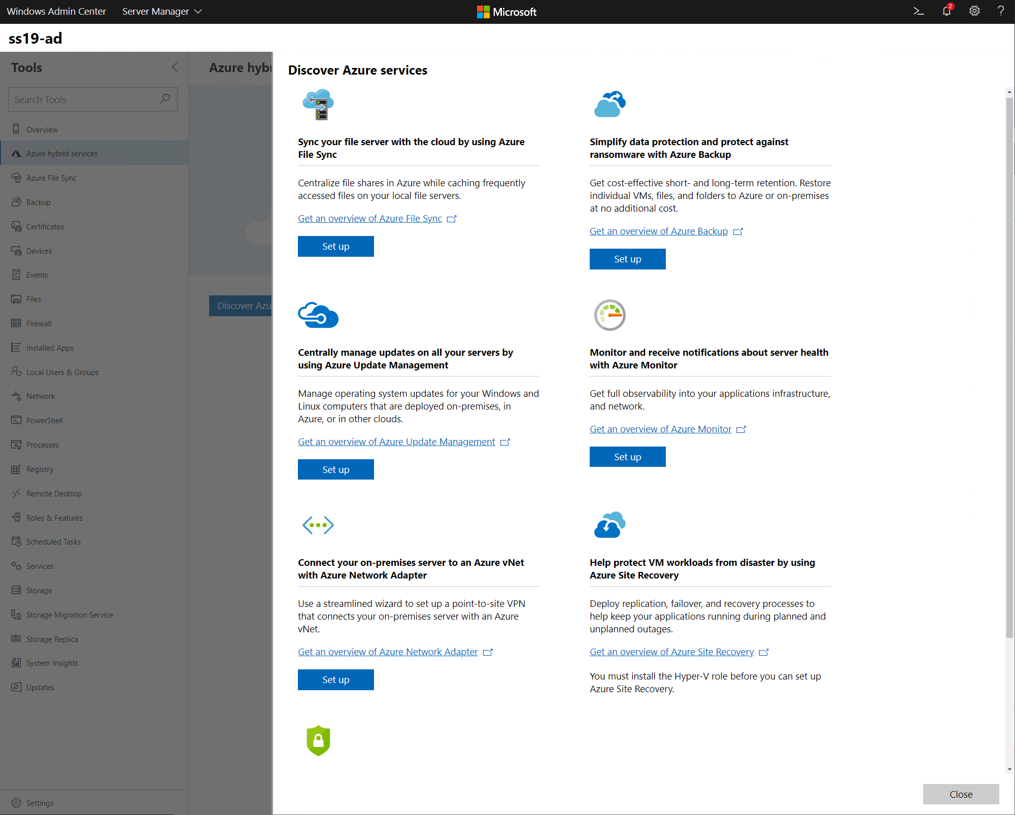
Windows Admin Center
https://aka.ms/WindowsAdminCenter

Slide 38

Migration Tools

Slide 39
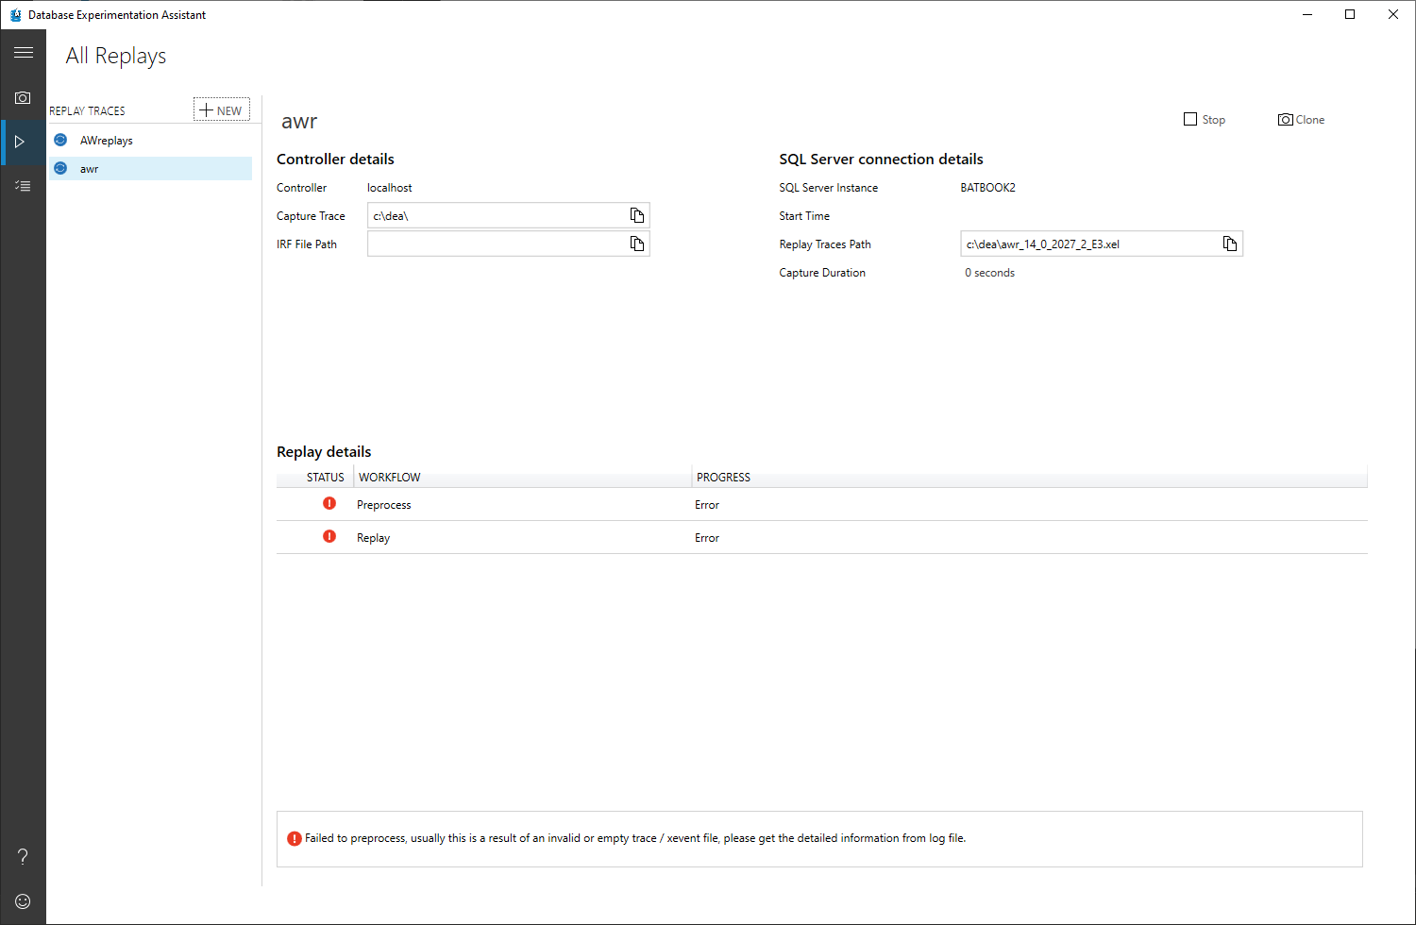
Data Experiment Assistant
https://aka.ms/azureDEA

Slide 40
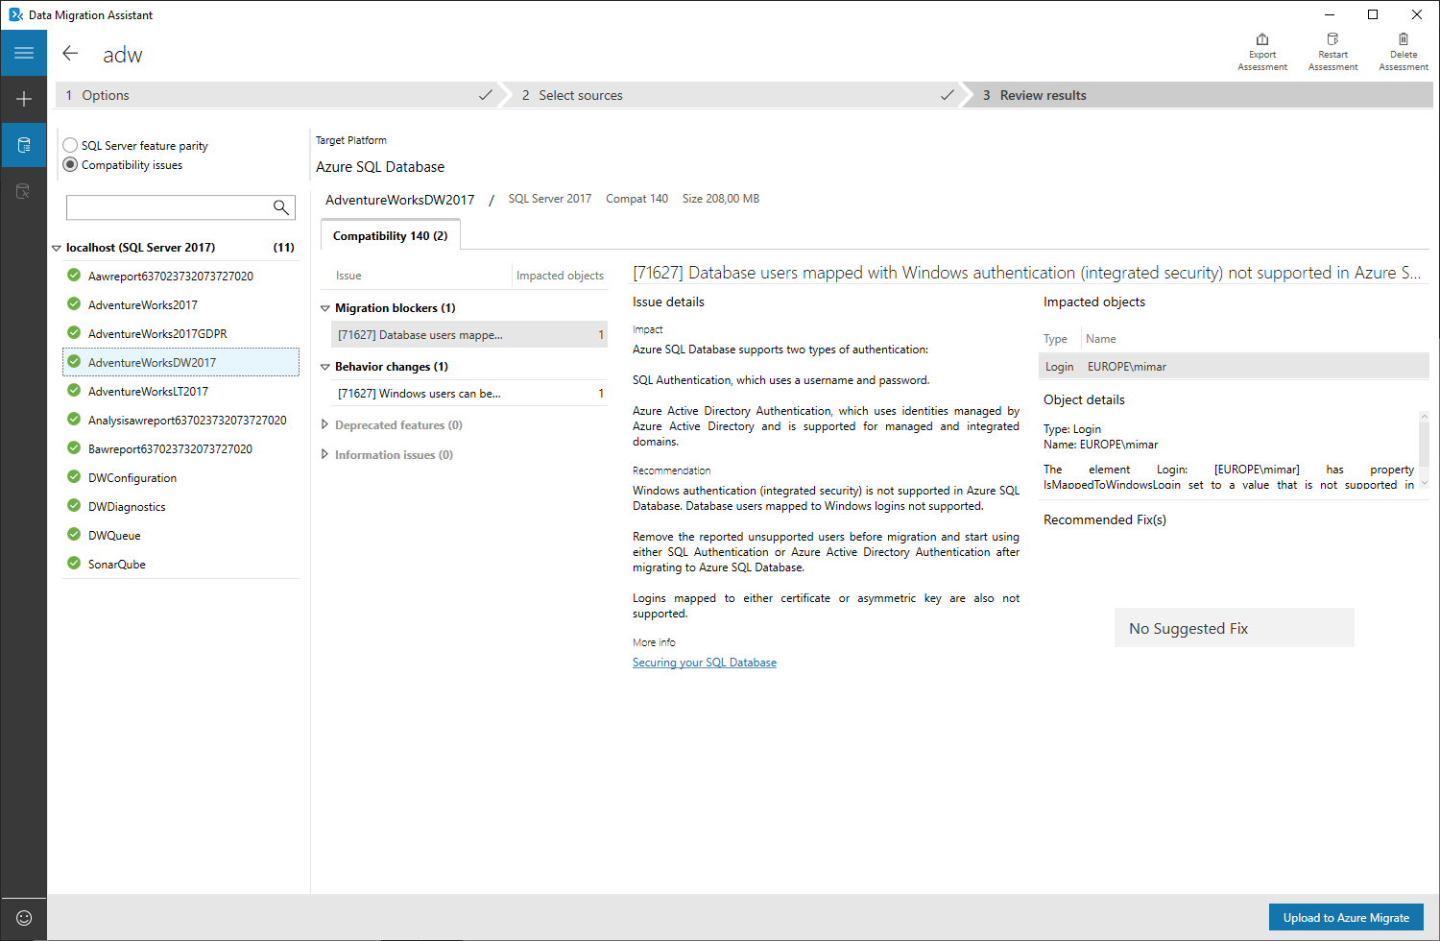
Data Migration Assistant
https://aka.ms/azureDMA

Slide 41
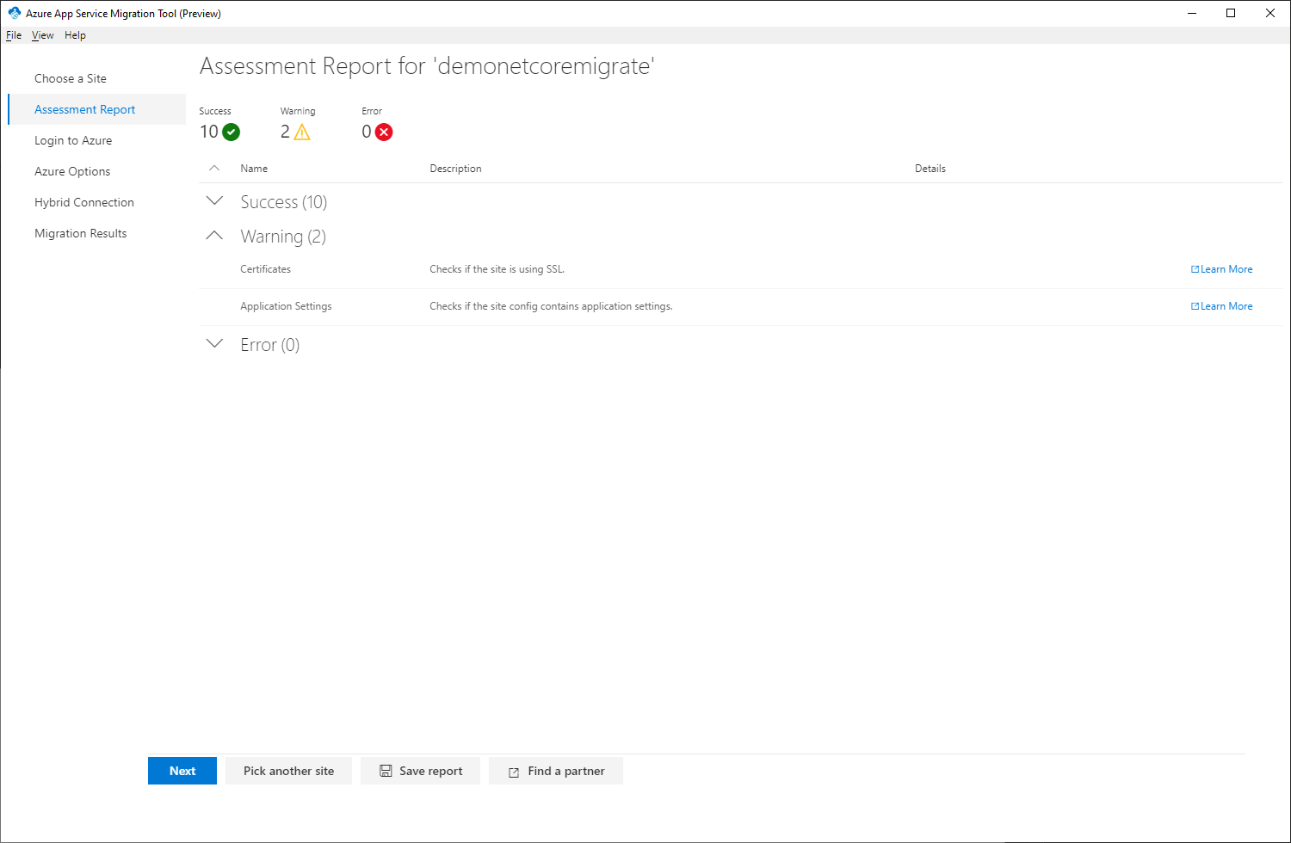
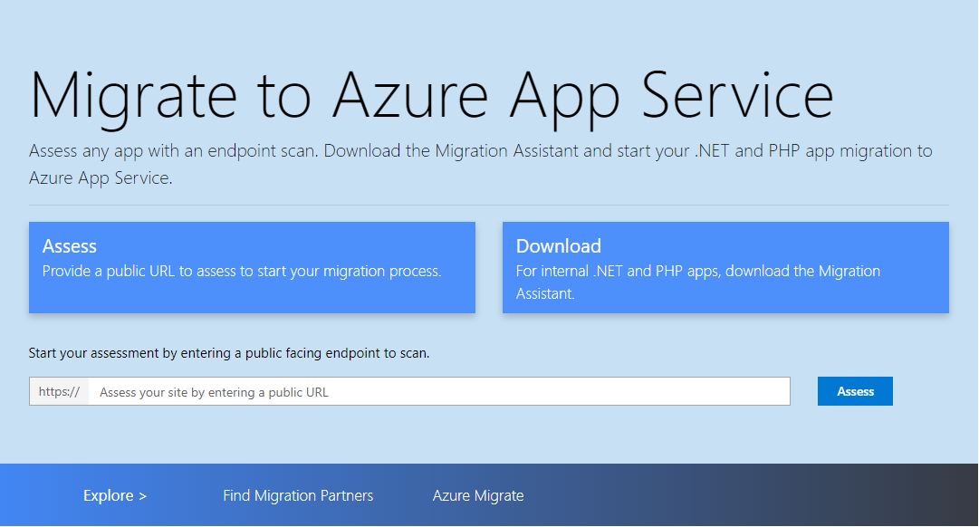
Azure App Service Migration Tool
https://appmigration.microsoft.com

Slide 42
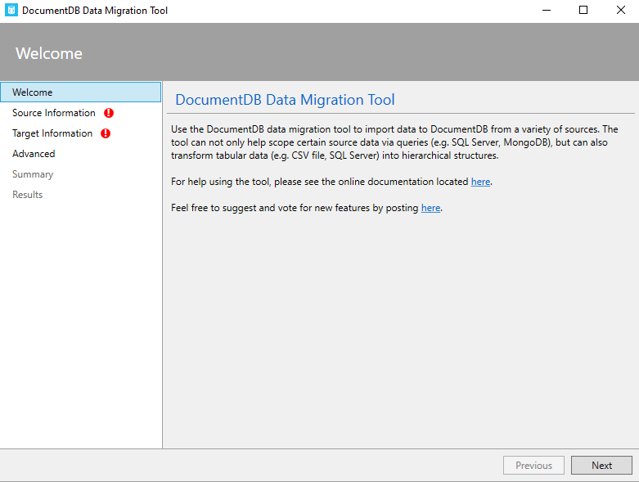
CosmosDB Data Migration Tool
https://aka.ms/csdmtool

Slide 43
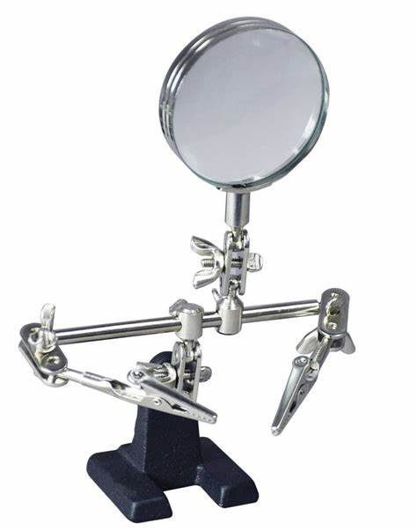
ARM

Slide 44
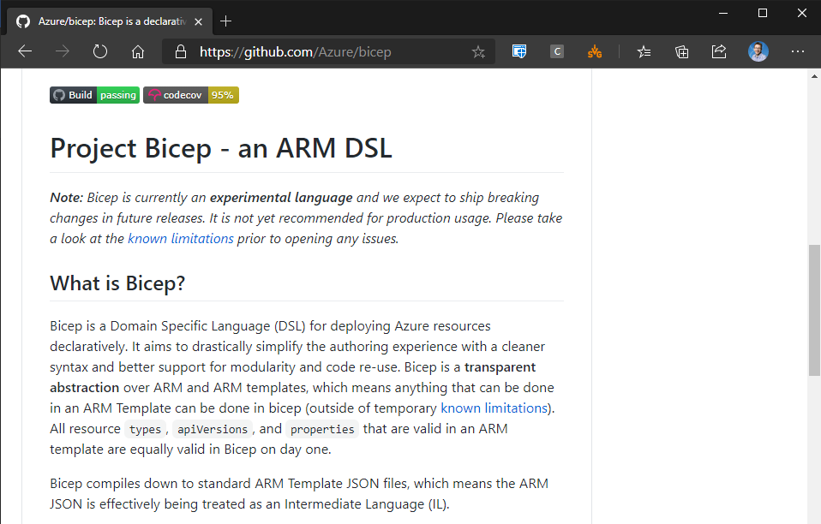
Project “Bicep”
https://aka.ms/bicep

Slide 45
PSArm - Project “Bicep” for Powershell
https://aka.ms/bicep

Slide 46
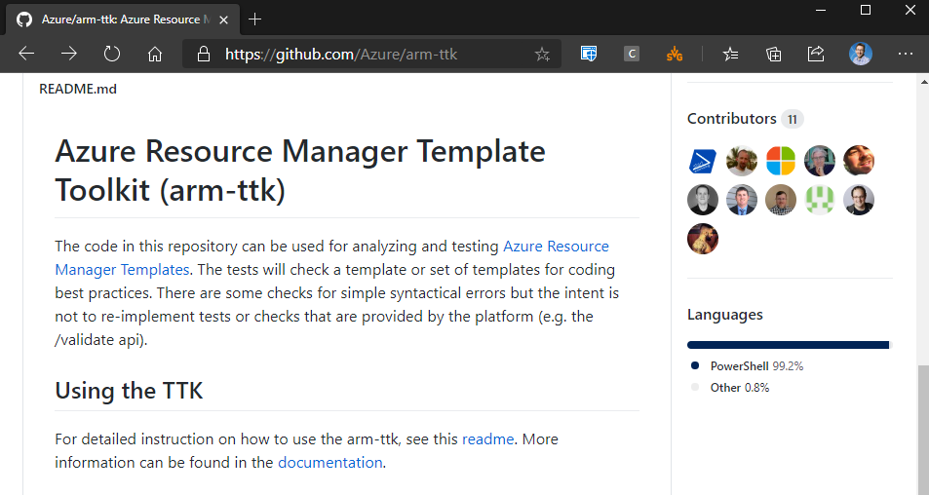
ARM-TTK
https://aka.ms/arm-ttk

Slide 47
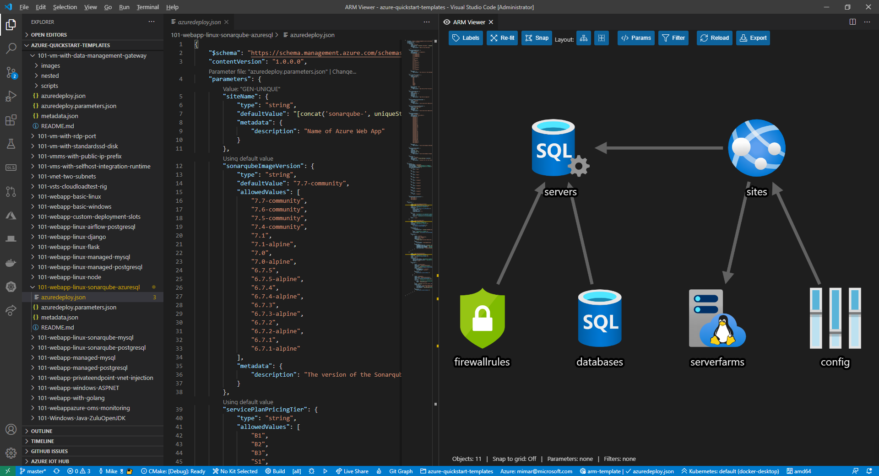
ARM Template Viewer
https://aka.ms/armview

Slide 48
AzViz Powershell Module
Install-Module AzViz –Force
(needs chocolatey packageprovider)

Slide 49
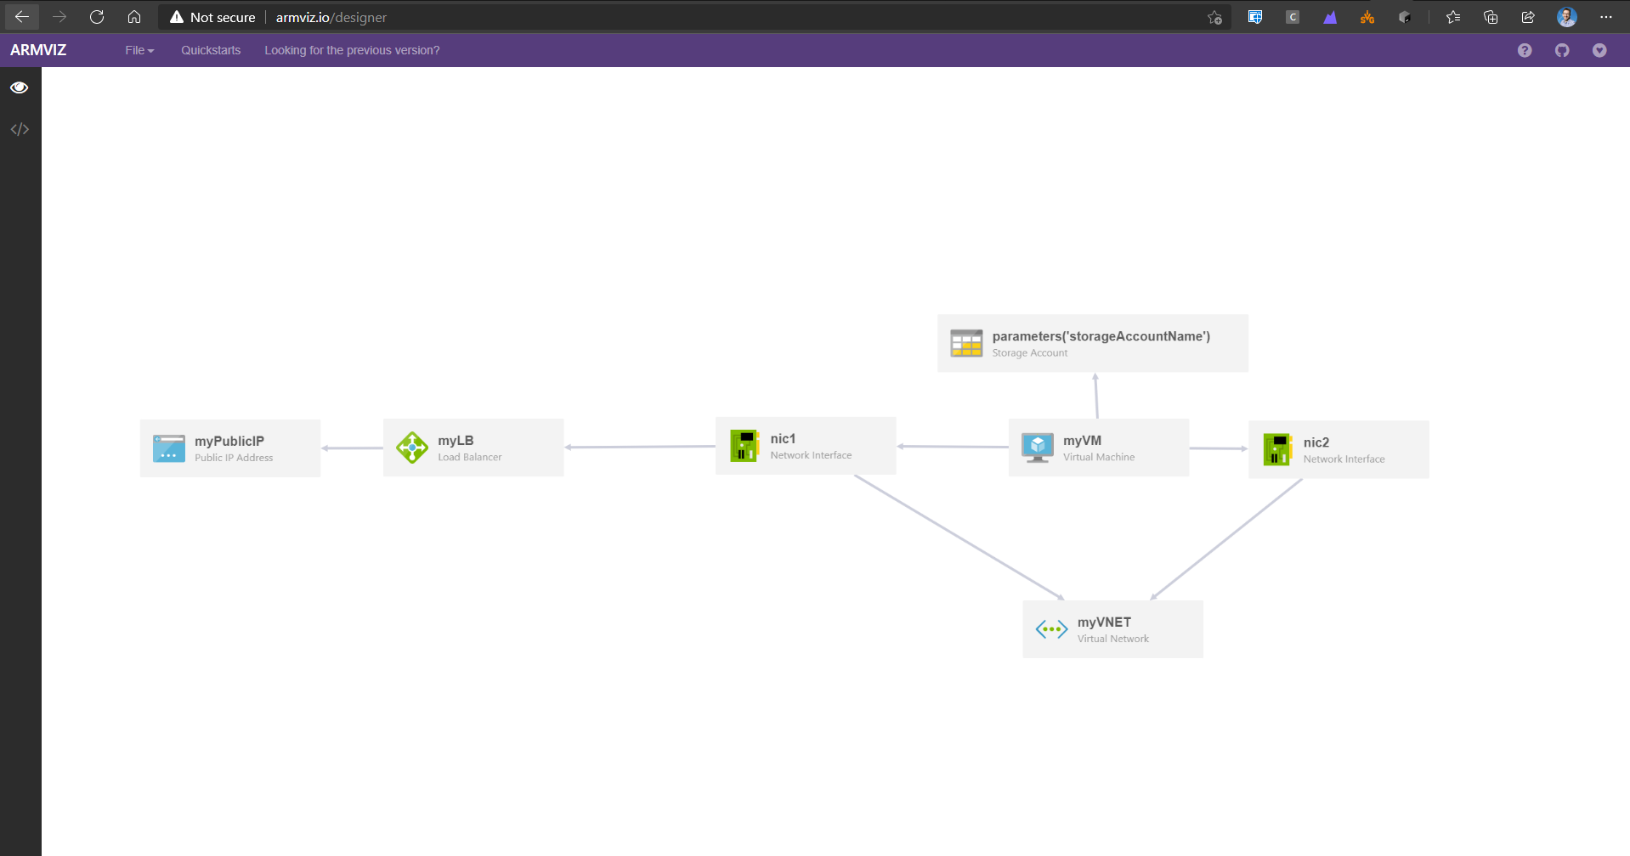
ARMViz.io
https://armviz.io

Slide 50
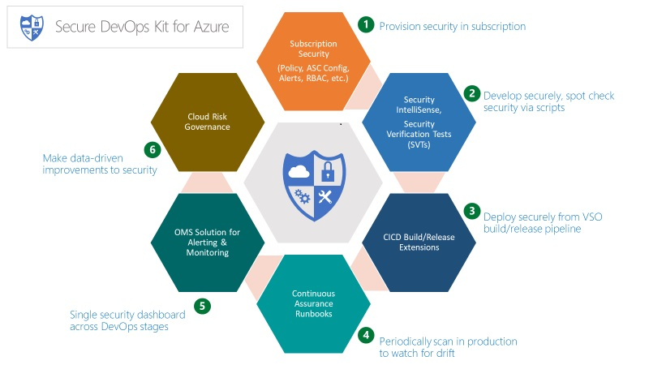
Secure DevOps Kit for Azure
https://aka.ms/azskdevops

Slide 51
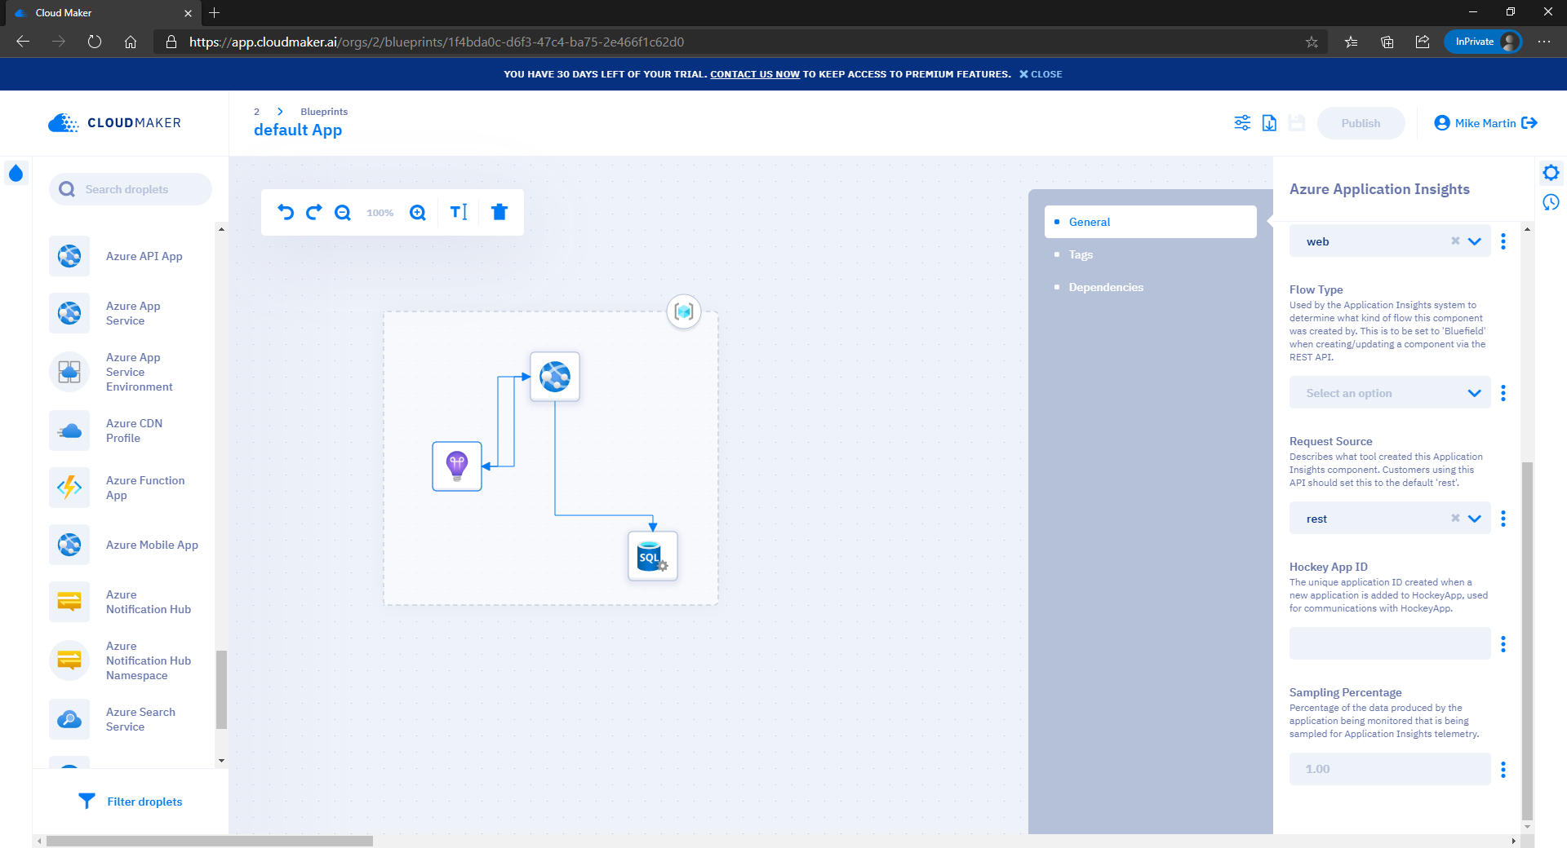
Cloudmaker.AI
https://cloudmaker.ai

Slide 52

Speedguns

Slide 53
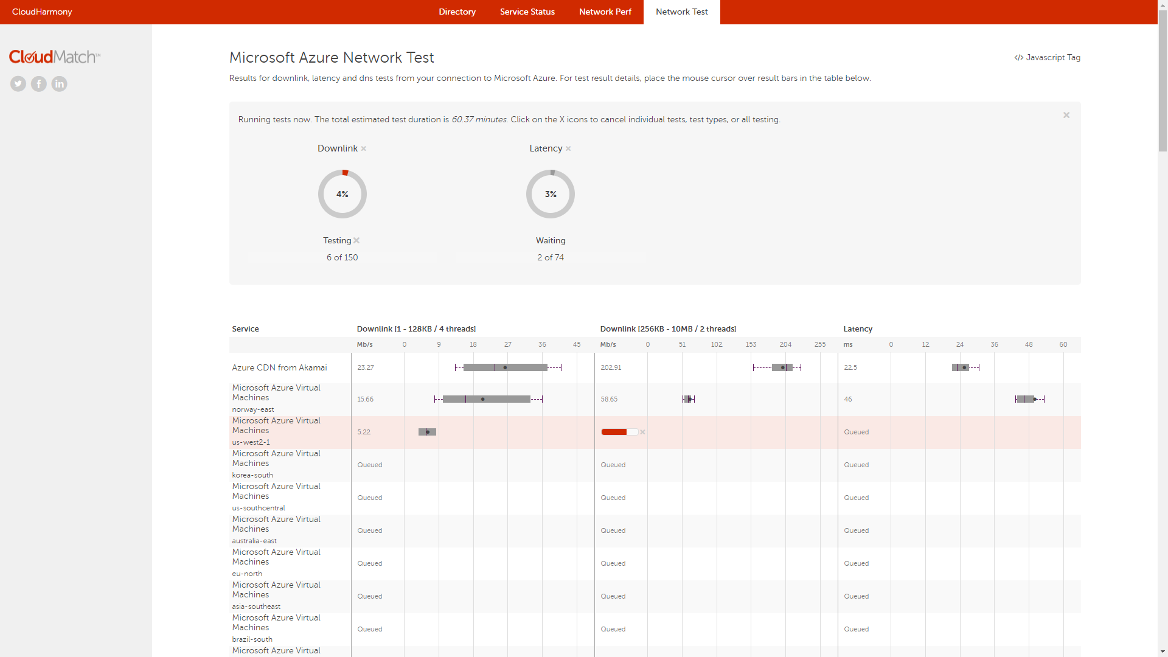
Cloudharmony
https://cloudharmony.com/speedtest-for-azure

Slide 54
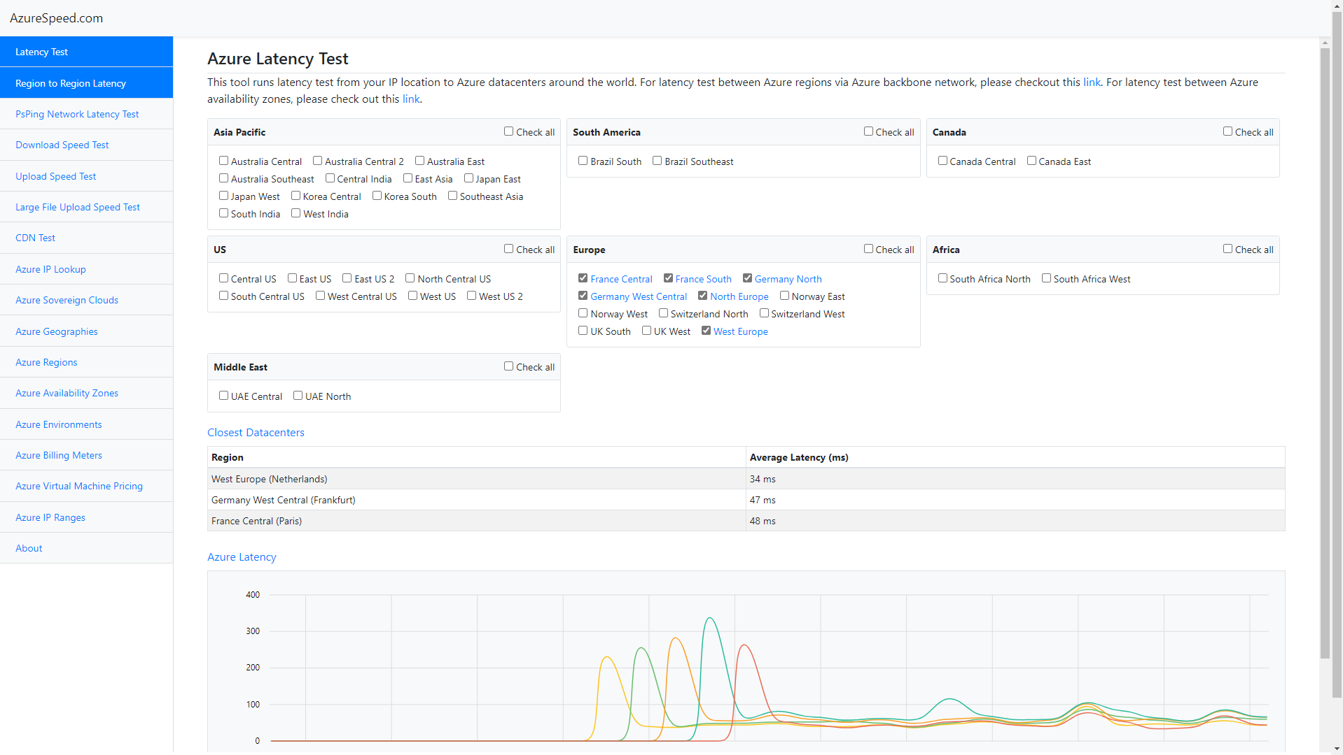
Azure Speed
https://azurespeed.com

Slide 55
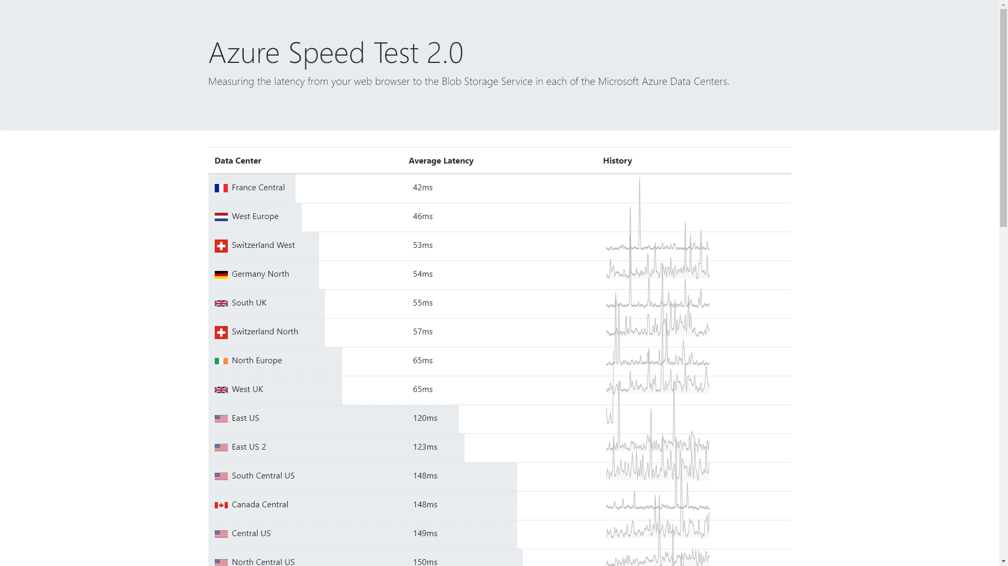
Azure Speedtest
https://azurespeedtest.azurewebsites.net

Slide 56
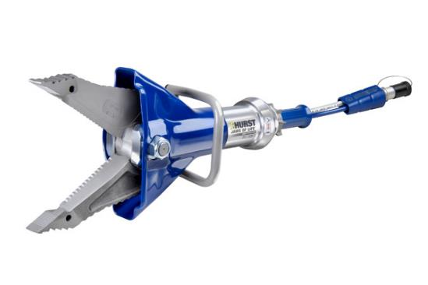
Tools that can save your live (& HIDDEN GEMS)

Slide 57

Cloudockit
https://cloudockit.com

Slide 58

Excel
https://office.com

Slide 59

Service Bus Explorer
https://github.com/paolosalvatori/ServiceBusExplorer

Slide 60

Cerebrata’s Cerulean
https://www.cerebrata.com/products/cerulean

Slide 61

RedisInsight
https://redislabs.com/redis-enterprise/redis-insight/

Slide 62

Azure Data Studio
https://aka.ms/azuredatastudio

Slide 63

Alpaqa Studio
https://alpaqastudio.com

Slide 64

Storage Explorer
http://aka.ms/azurestorageexplorer

Slide 65

Other
https://azure.microsoft.com/en-us/documentation/articles/storage-explorers/

Slide 66

Batch Explorer
https://azure.github.io/BatchExplorer/

Slide 67

Azure Keyvault Explorer
https://aka.ms/ve

Slide 68

Azure Kusto.Explorer
https://aka.ms/ke

Slide 69

Azure Media Services Explorer
https://aka.ms/amse

Slide 70

Azure Media Player
https://aka.ms/amseplay

Slide 71

PowerBI
https://powerbi.com

Slide 72


Grafana
https://grafana.com

Slide 73

SSMS
https://aka.ms/ssms

Slide 74

CosmosDB Capacity Calculator
https://cosmos.azure.com/capacitycalculator/

Slide 75

SQL DTU Capacity Calculator
http://dtucalculator.azurewebsites.net/

Slide 76

Resources.azure.com
https://resources.azure.com/

Slide 77

VMChooser
https://vmchooser.com

Slide 78

Azure VM Selector
Microsoft Azure VM Selector
https://azure.microsoft.com/en-us/pricing/vm-selector/

Slide 79

Azure IoT Accelerator
https://www.azureiotsolutions.com/Accelerators

Slide 80

Azure IoT Explorer
https://github.com/Azure/azure-iot-explorer

Slide 81
Our Sponsors
GOLD
COMMUNITY

Slide 82


Slide 83

ARM

Slide 84

Speedbumps

Slide 85

Message Analyzer
https://aka.ms/messageanalyzer

